Slide 1
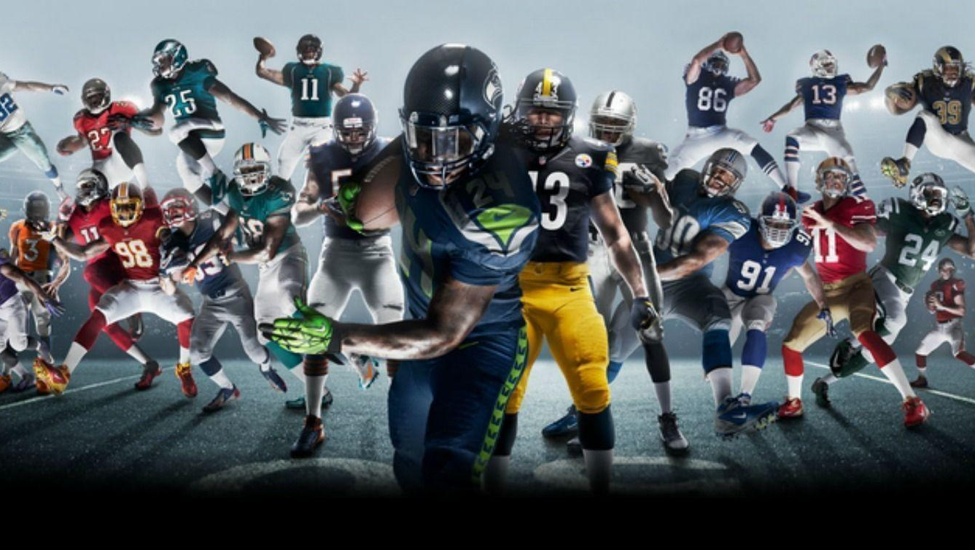
Make the Right Pick
John Wujciak

Slide 2

Outline
Predicting individual player performance for “fantasy football.”
Fantasy Football Background.
American, NFL.
Based on real football performance.
Competitive.
$.

Slide 3
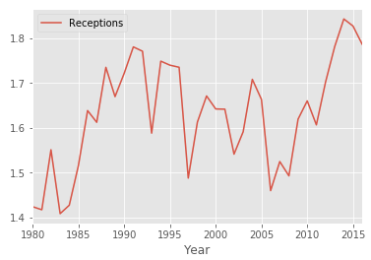
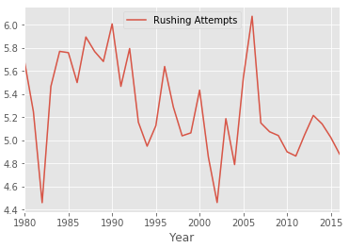
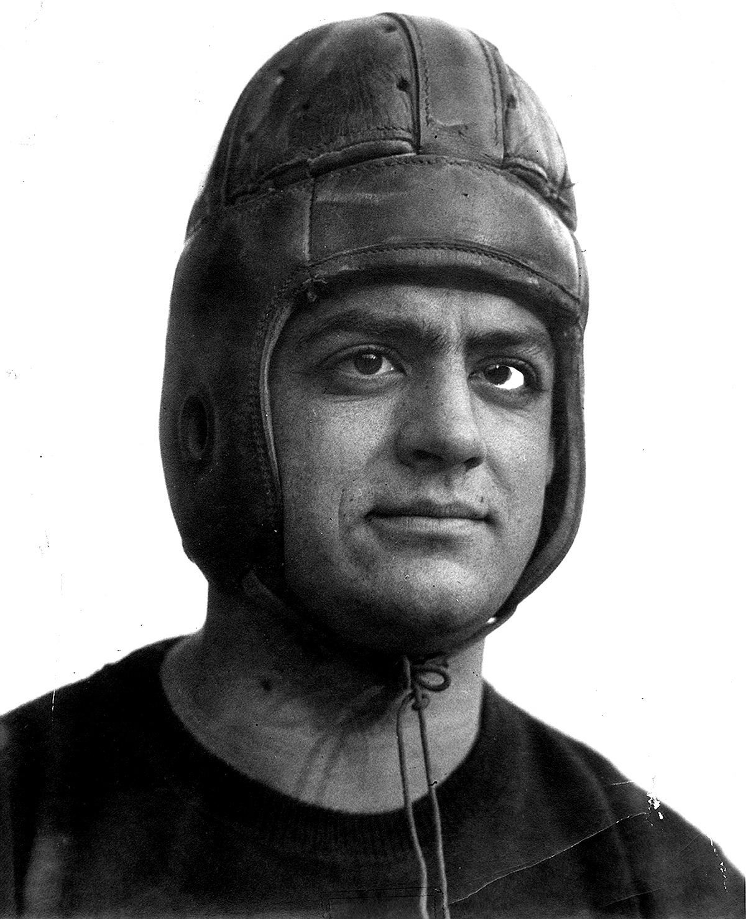
Goal and Dataset
Goal: A fantasy football magic 8-ball.
Direct vs. Indirect indicators of scoring.
Data: Kaggle.
One position: RBs.
Modern Era only: 1980+.
Notes:
A reproducible program to input a player’s name and see if he would be a good pick. Compare to other players.
There are metrics that are directly used in scoring: Rushing Yards, TDs.
Original project was to see which indirect metrics were good “secret” indicators of future production.
Data was from Kaggle and was missing many of these fields that I theorized would be good indicators.
Restrict to one position for now: Running Backs.

Slide 4
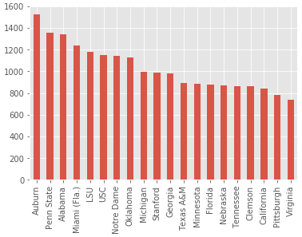
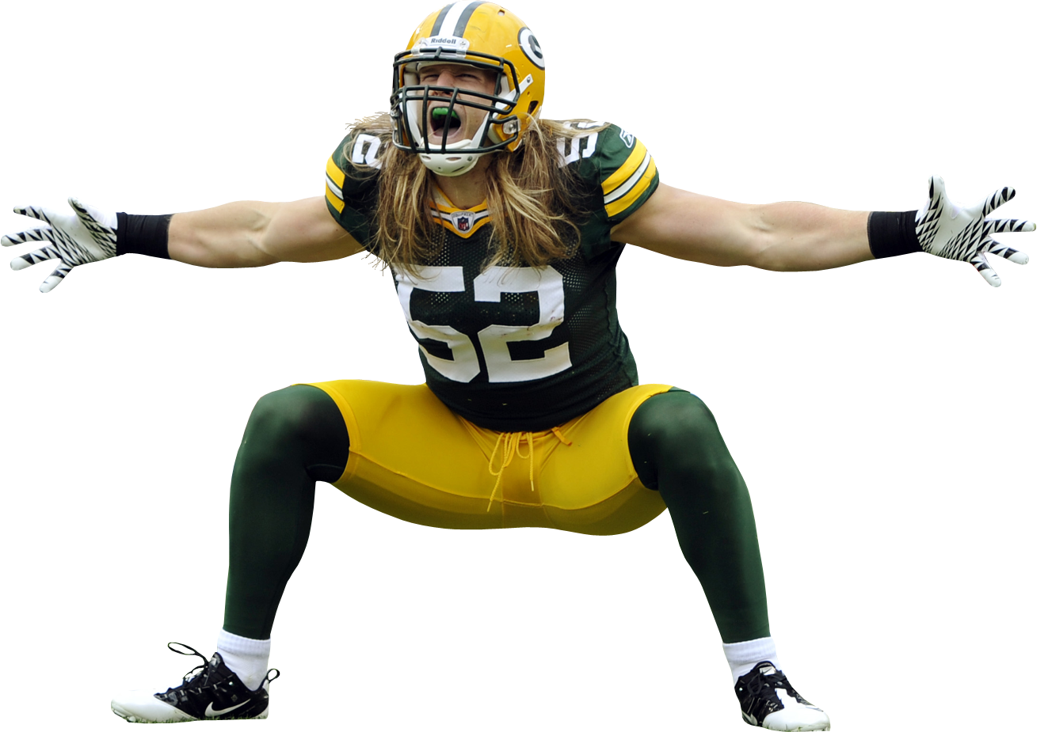
Steps
Too much scope.
Trying to find secret correlations in the wrong data.
Time Series Models > Log Regression.
Notes:
Average career in the NFL is 4-5 years so there is just a ridiculous number of different running backs over the course of ~40 years
The overwhelming majority of the running backs touch the ball so little they are not relevant for fantasy football.
Moreover most of the running backs who go from fantasy irrelevance to household names have no NFL data available, either because they have not been given a chance in the NFL or they just joined the NFL and their information lives in a collegiate dataset.
And like I said, there were a few indirect metrics that might be able to indicate whether an underutilized player is actually very talented, and those metrics were largely unavailable.
So I shifted my thought process from “have a machine pick from all players based on all metrics” to “have a machine help you decide between a few players you already think are comparable.”

Slide 5
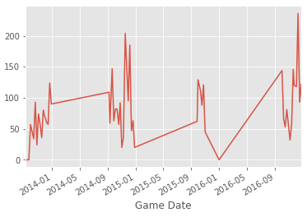
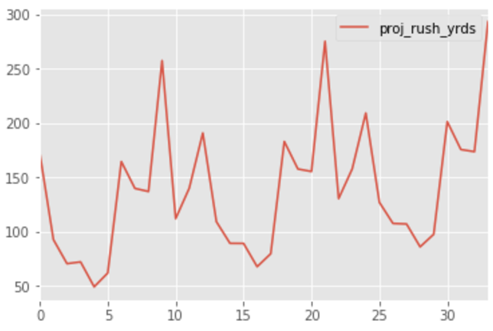
Insight #1
Le’veon Bell
Notes:
Massive Seasonality in football makes actual dates irrelevant. All time series data will be portrayed by number of games. 1 Season = 17 games

Slide 6
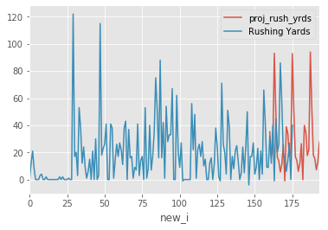
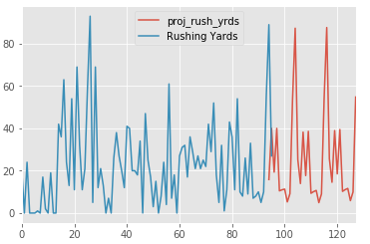
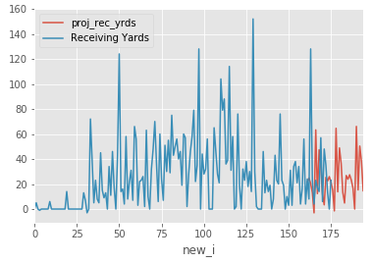
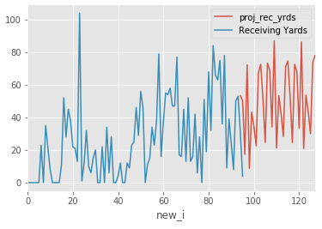
Insight #2
Darren Sproles
Danny Woodhead
Which Running Back Would You Choose?
Both are good at running and catching the ball.
Notes:
Darren Sproles (left) has a longer body of work but is older. Also has a higher ceiling in rushing and receiving yards.
Danny Woodhead (right) has lower floors and seems to be trending up as a receiver.
This disproves any model that attempts to predict future success, without caveats.

Slide 7
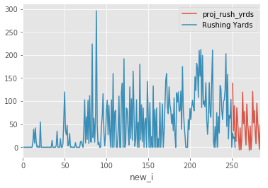
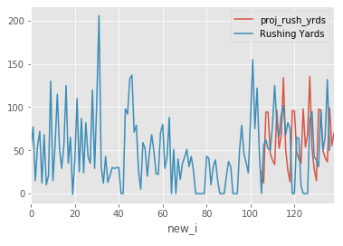
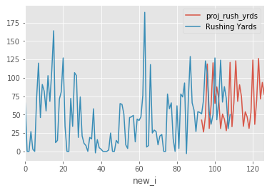
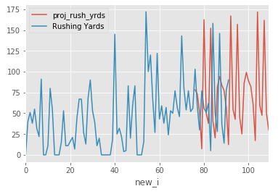
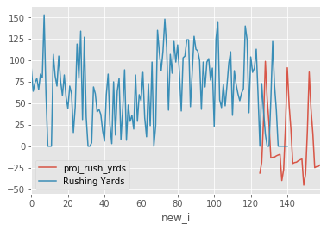
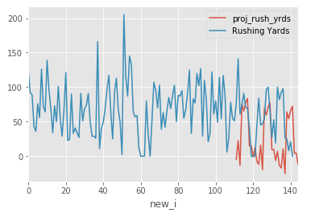
Insight #3
Actually Using the Model
Adrian Peterson
Jonathan Stewart
Lagarrette Blount
Mark Ingram
Marshawn Lynch
Matt Forte
Notes:
Adrian Peterson is going to fizzle into mediocrity.
Jonathan Stewart and Lagarrette Blount are going to stay solid. Not improve or decay.
Ingram is going to continue moving up.
Marshawn Lynch and Matt Forte are going to plummet.
ESPN was actually advising picking Lynch, Peterson and Forte above Ingram, Stewart and Blount.
Based on the 2017 data we are already seeing, you should have actually flipped the two groups.
This actually helps prove the usefulness of the model.

Slide 8

Modelling Approach
Creates a differenced view
Get the inverse of the difference week to week
Apply the inverse of the seasonal difference to correct for seasonality
Applies an ARIMA Model
Mean Absolute Error of around 40-60 rushing yards
Notes:
Human guided in which metric it optimizes for, but it takes existing data and forecasts based on that.
Corrects for some seasonality although there was not much outside of the fact that data is missing for half the year.
After looking at a bunch of individual running backs’ rushing yardage projections, MSE is usually around 40-40 yards.
Would have liked MSE to be lower but 40-60 rushing yards is actually what you would see if an RB were going up against a good or bad defense or if an RB were playing with an injury or what kind of game it will turn out to be.
So as the user, you can look at information outside of the model (like opponent) and make your own decision where the actual number will fall.
Again the tool is built as an aid to a someone who knows a bit about football.

Slide 9
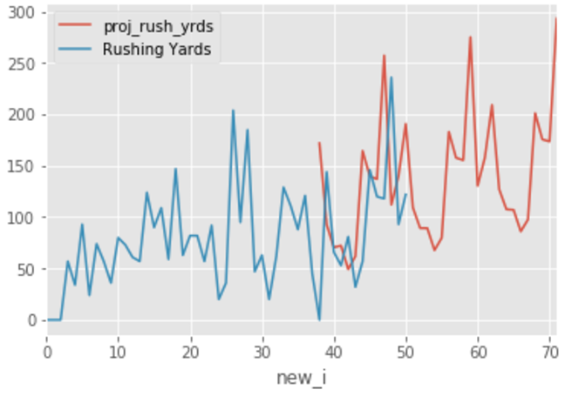
Results
Younger players can break the model
Most effective for middle of the pack players
Overfit?
Actually fits the data pretty well
Does a good job of prioritizing more recent years when training the model
Le’veon Bell
Notes:
Rookies obviously have no NFL data but players who were only in the league in 2015 and 2016 have broken the model before. And recoding to check one or two players obviously goes against my goal of balancing ease of use with actionable data.
Players who have skyrocketed recent years are destined to plateau at some point.
May be overfitting (in context) because a bad game in the middle of the season does not necessarily mean he will always suck in games 6,7,8. It could mean an injury or tough opponent.

Slide 10
Conclusion
ESPN
2017 So Far
My Model
2017 So Far
Lynch
Ingram
Peterson
Forte
Stewart
Blount
Blount
Ingram
Stewart
Lynch
Forte
Peterson
Ingram
Blount
Stewart
Peterson
Forte
Lynch
Blount
Ingram
Stewart
Lynch
Forte
Peterson
x
~
✔️
~
x
✔️
~
x
x
✔️
x
x
Notes:
Basically, if I were deciding which of these middle of the pack running backs I would want on my team, ESPN was almost completely misleading, whereas my predictions get pretty close. Most importantly, my model knew who you wouldn’t want to pick, but just didn’t effectively predict the degree of suckiness.

Slide 11
Going Forward
Solidify knowledge of ARIMA model
Try with another position
Check more of the direct indicators of success
Try some more models out
Notes:
ARIMA Model is very powerful, I want to study up a little bit on how to use it in different scenarios and how to tweak it.
Maybe I could do that while reproducing this study for another position like Receivers.
If someone has a good foundation of football, you could clear the fog of strictly qualitative analysis and make picks more on their actual performance to date. I have already acquired a running back who I have always written off based on this study. We will see how it works out ☺.

Slide 12
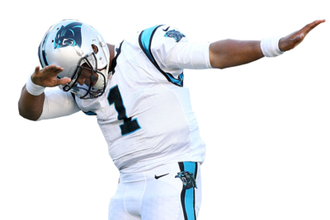
Acknowledgements
Stefan Jansen
Neha Srivatsa
Sean Godfrey
Citations: Kaggle, ESPN

